Slide 1

INTRODUCTION TO MACHINE LEARNING
Gede Angga Pradipta M.Eng

Slide 2
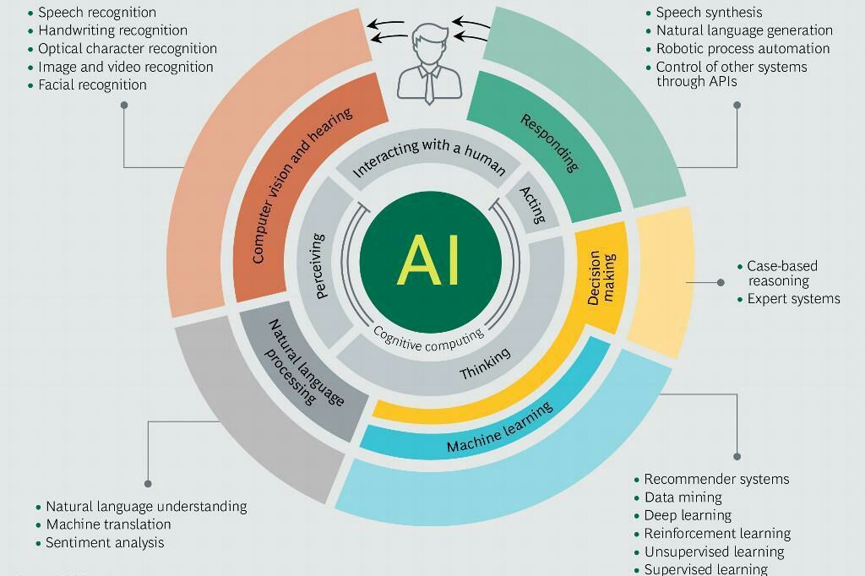
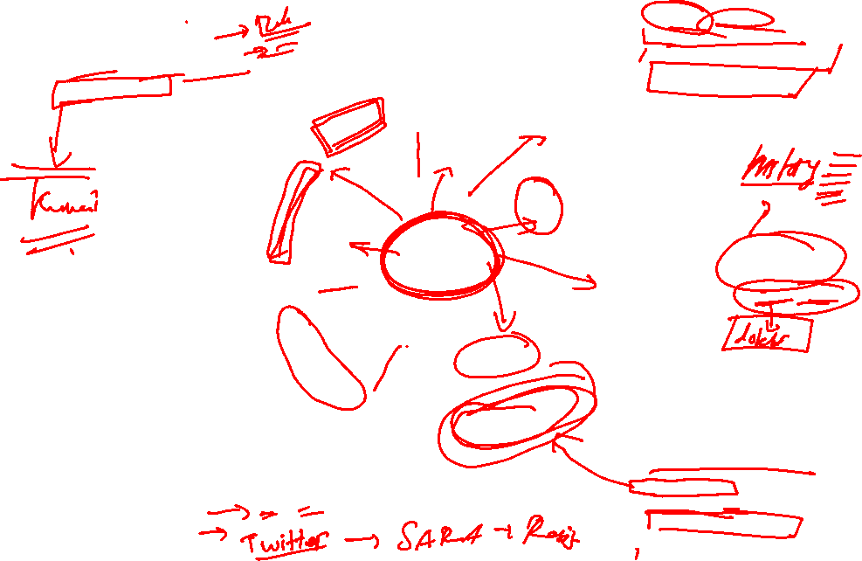

Slide 3
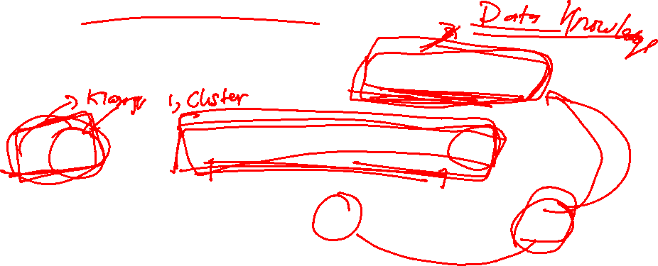
Machine Learning ?
“ A Computer program is said to learn from experience (E) with some class of tasks (T) and a performance measure (P) if its performance at task in T as measured by P improves with E “
(Tom Mitchell, 1977)

Slide 4
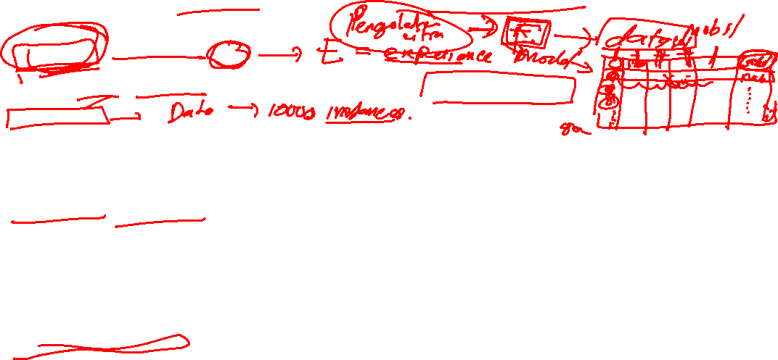
Some Important Terminologies
Trainning/Evolution Set
Set of data to discover potentially predictive relationships.
Instances
A sample is an item to process (e.g. classify). It can be a document, a picture, a sound , a video, a row in database or CSV file, or whatever you can describe with a fixed set of quantitative traits.
Features/attributes
The number of features or distinct traits that can be used to describe each item in a quantitative manner.
Feature vector
Is an n-dimensional vector of numerical features that represent some object.
Feature extraction
Preparation of feature vector
Transforms the data in the high-dimensional space to a space of fewer dimensions

Slide 5
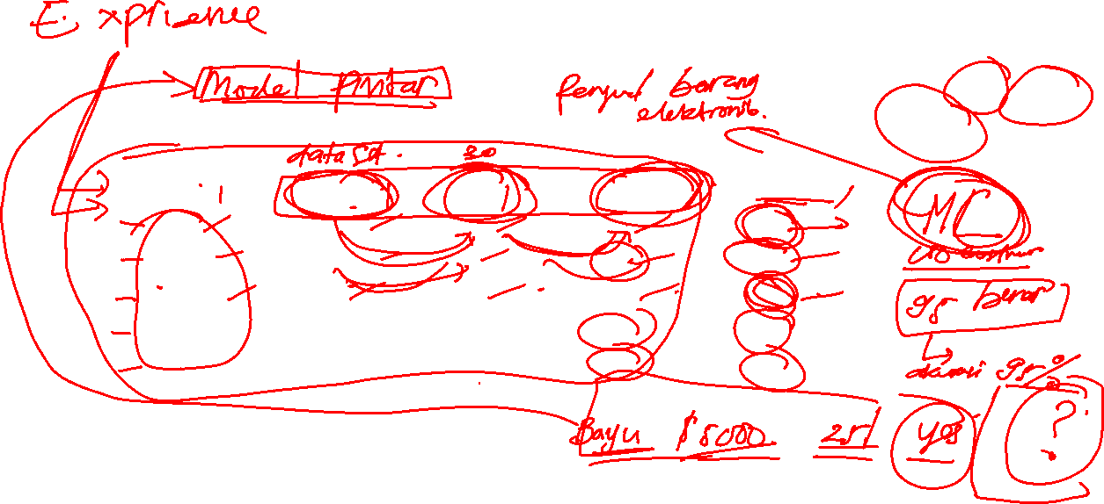
Attributes
Features
Class/label
Target Attributes
Name | Balance | Age | Employed | Write-off
Mike | $ 2000 | 31 | No | Yes
Mary | $13500 | 30 | Yes | Yes
Claudio | $200 | 21 | No | No
Robert | $5000 | 28 | Yes | Yes
David | $10000 | 42 | Yes | Yes
This is one row (example).
Feature vector is : <Claudio,200,21,No>
Class label (value of target attribute) is No
Instance

Slide 6

WHY MACHINE LEARNING ?

Slide 7
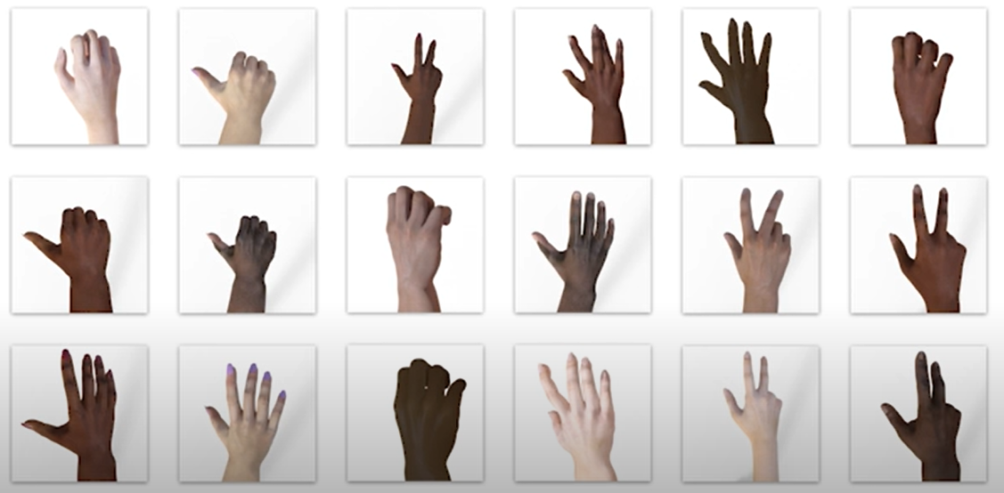
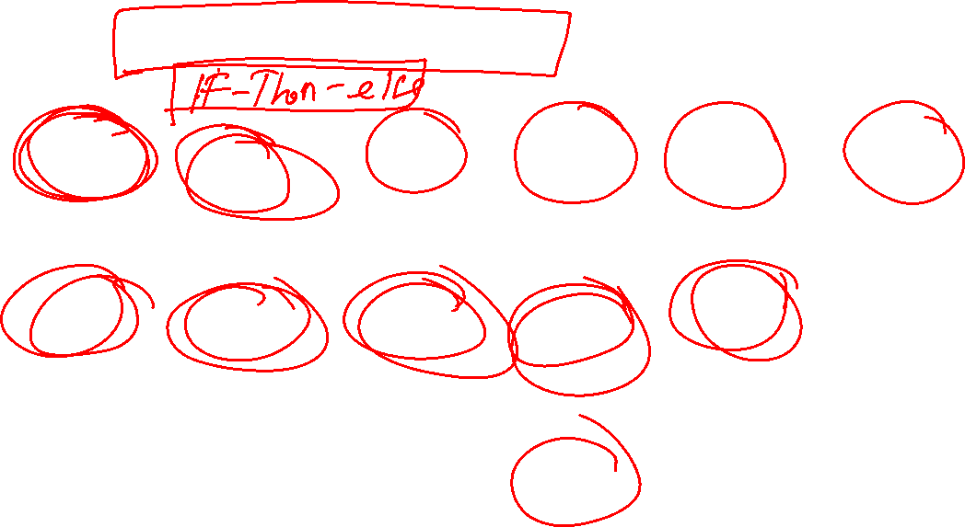
WHY MACHINE LEARNING ?

Slide 8
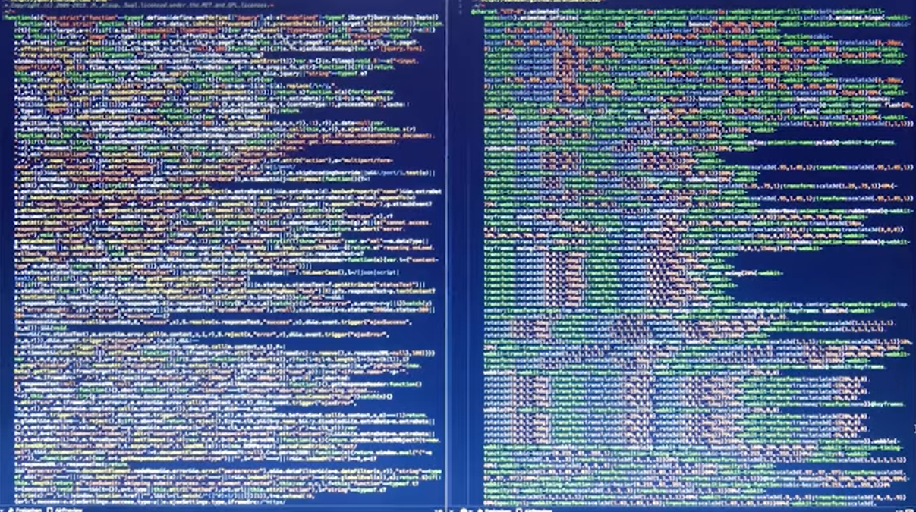
WHY MACHINE LEARNING ?

Slide 9
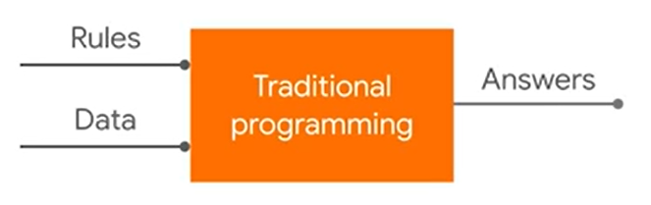
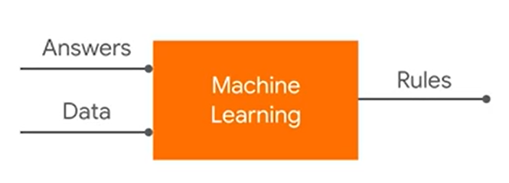
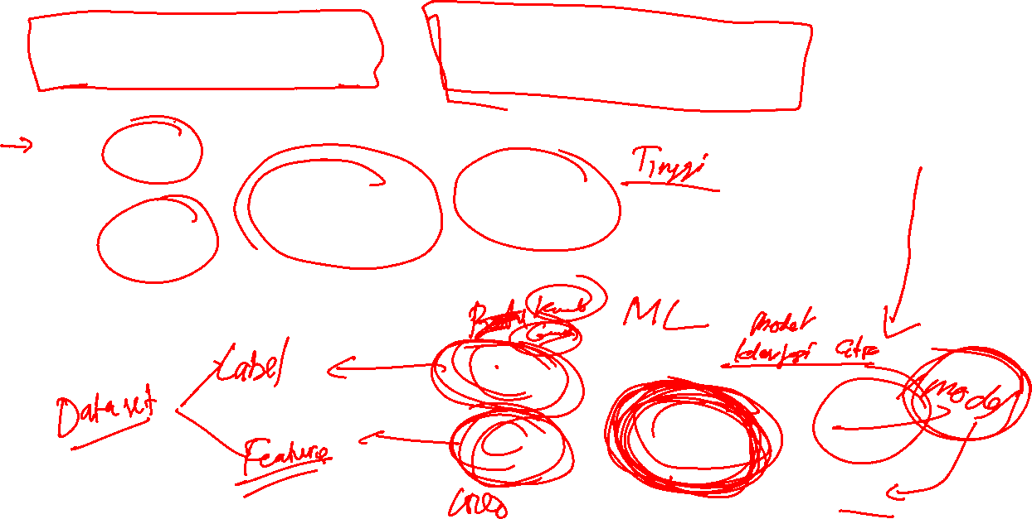
Traditional Code Vs Machine Learning

Slide 10
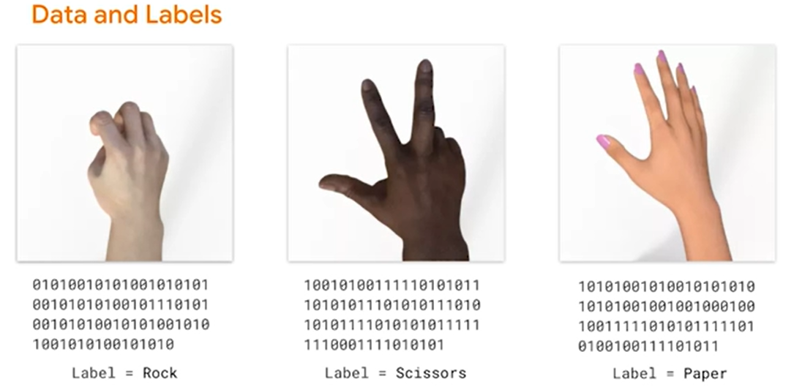
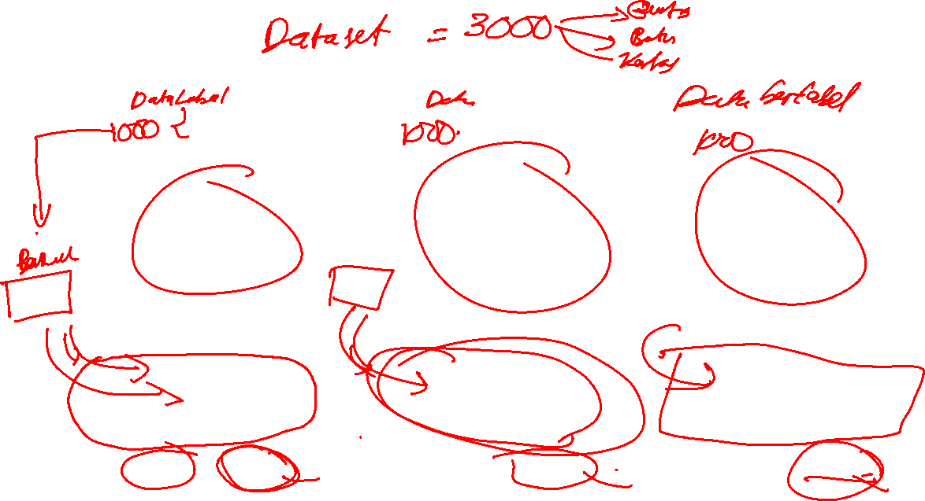

Slide 11
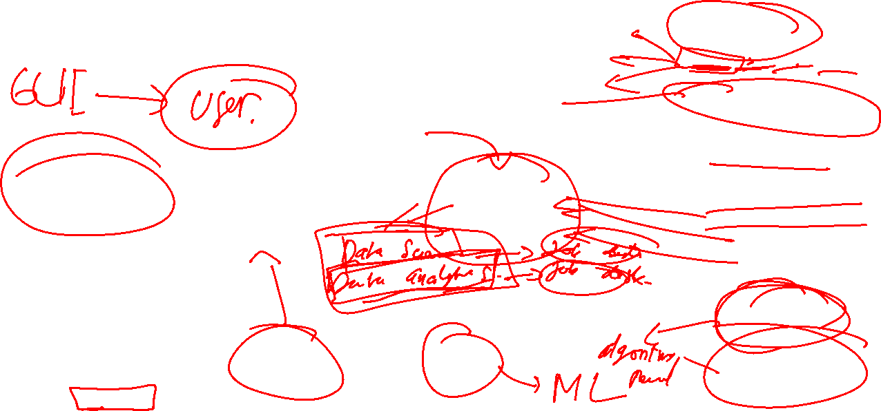
Machine Learning Pipeline
Data acquisition (image,text,sound,video,etc)
ML Problem check list
Defining Problem
Preparing Data
Check Algorithms
Improve result
Present result
Removing noise ( e.g Tomek-Links)
Oversampling data
Feature Engineering
Feature Selection
Data transformation
Present final performance
Performance measurement
Evaluate different model
Tuning parameter
Build Ensemble Model

Slide 12

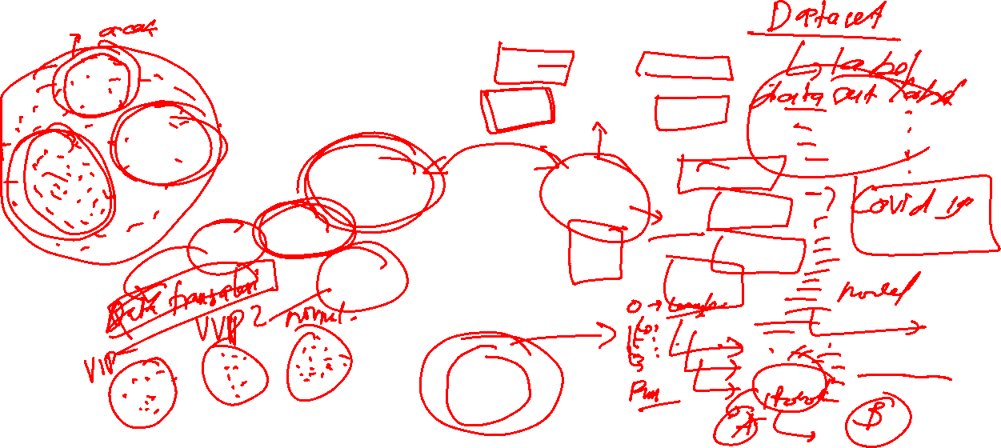
Types of machine learning

Slide 13
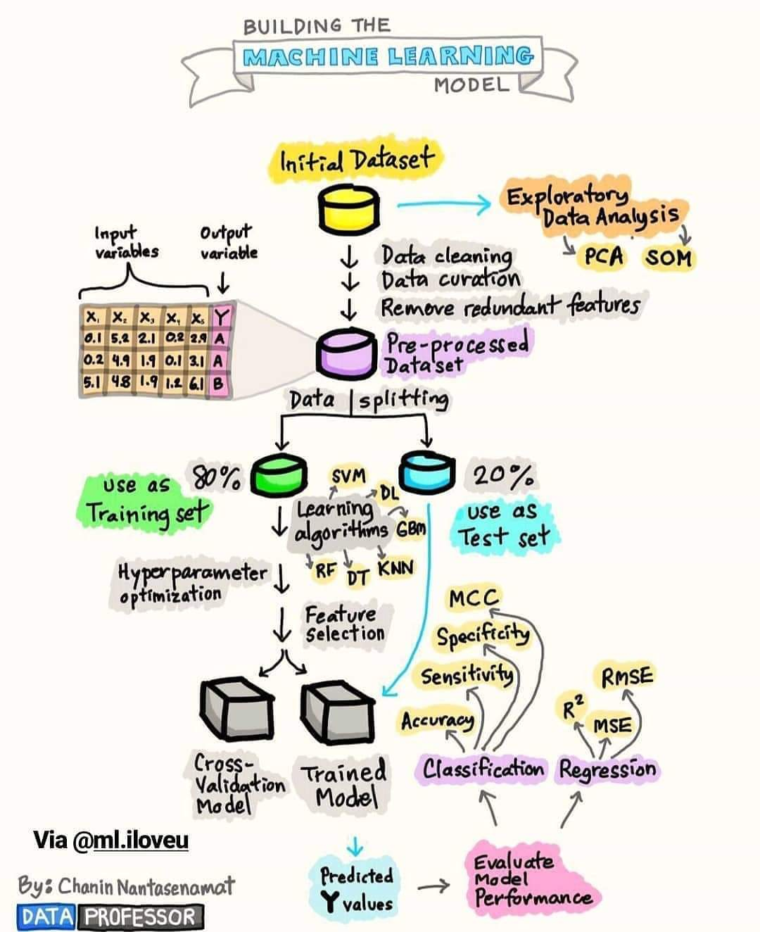
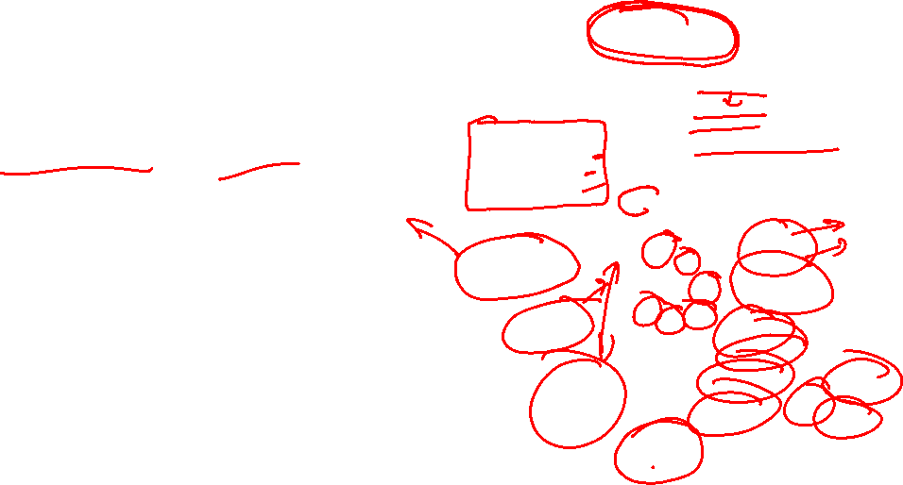
Supervised Machine Learning

Slide 14
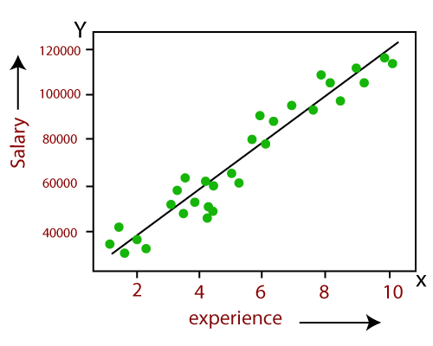
Supervised learning (Regression)
Regression is a measure of the relation between the mean value of one variable (e.g. salary) and corresponding values of other variable (e.g experience).
Regression analysis is a statistical process for estimating the relationships among variables.
Regression means to predict the ouput value usong training data.
Basic algorithm: linier regression

Slide 15
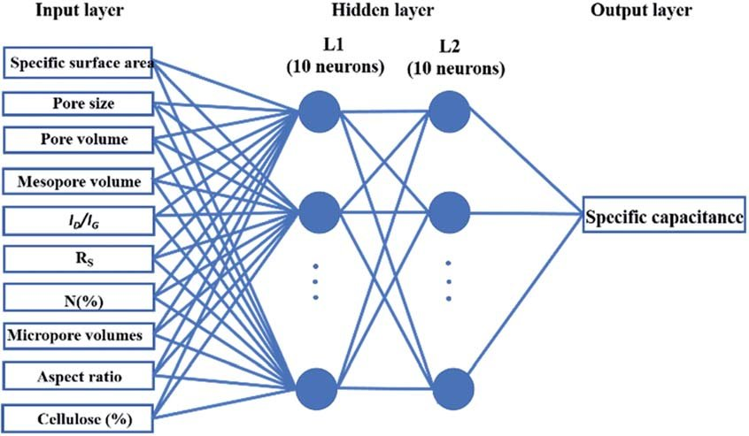
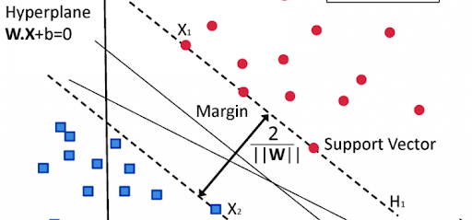
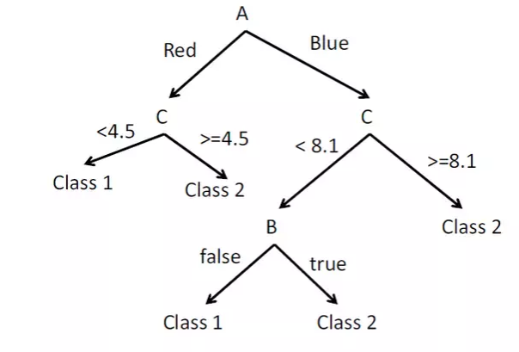
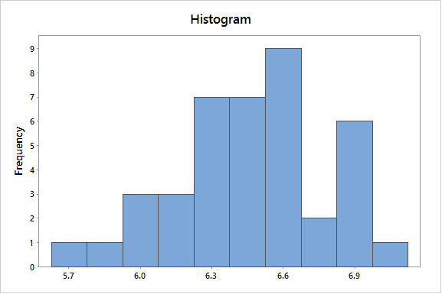
Supervised learning (Classification)
Nerual network model
Geometric model
Logical Model/rule based model
Probabilistic model

Slide 16
Differences between classification and regression
A classification problem requires that examples be classified into one of two or more classes.
A classification can have real-valued or discrete input variables.
A problem with two classes is often called a two-class or binary classification problem.
A problem with more than two classes is often called a multi-class classification problem.
A problem where an example is assigned multiple classes is called a multi-label classification problem.
A regression problem requires the prediction of a quantity.
A regression can have real valued or discrete input variables.
A problem with multiple input variables is often called a multivariate regression problem.
A regression problem where input variables are ordered by time is called a time series forecasting problem.

Slide 17
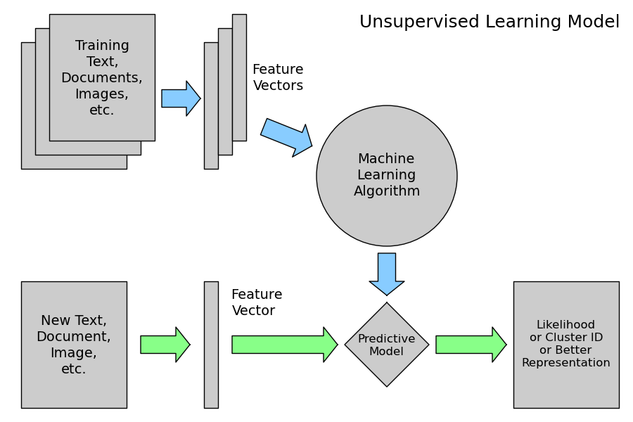
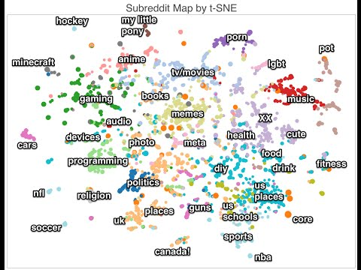
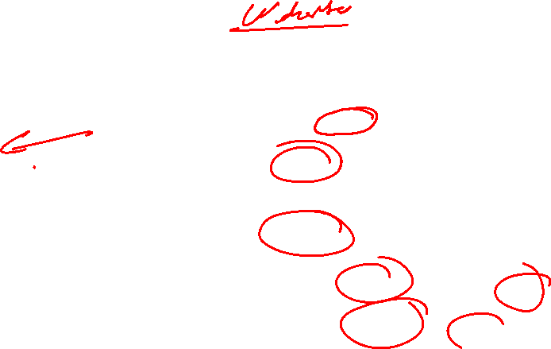
Unsupervised learning
Source : sckit-learn.org

Slide 18

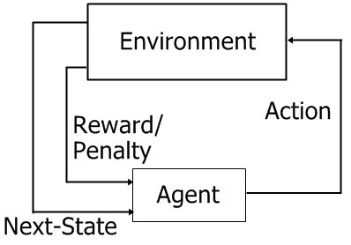
Reinforcement Learning

Slide 19
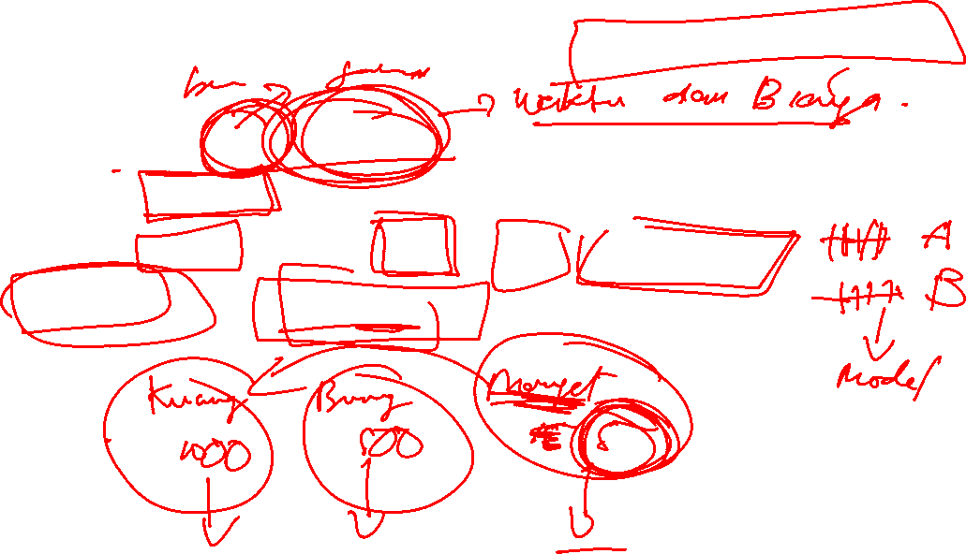
Some challenges task of machine learning
Difficult to data collection/Acquisition
Not all features useful to find good model (Curse of Dimensionality)
Some dataset contains noise/outlier/redundant data
Small data and Imbalance data

Slide 20
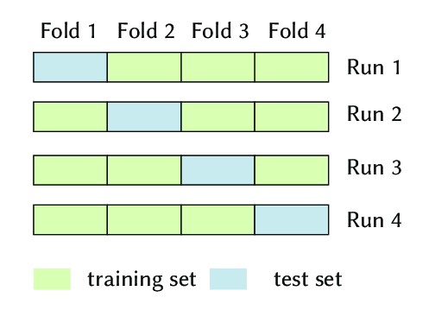
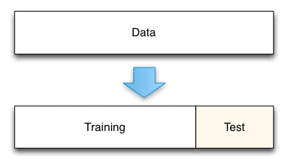
How to evaluate/Validate ML Model
K- Fold Cross Validation
Train-Test Data Split

Slide 21
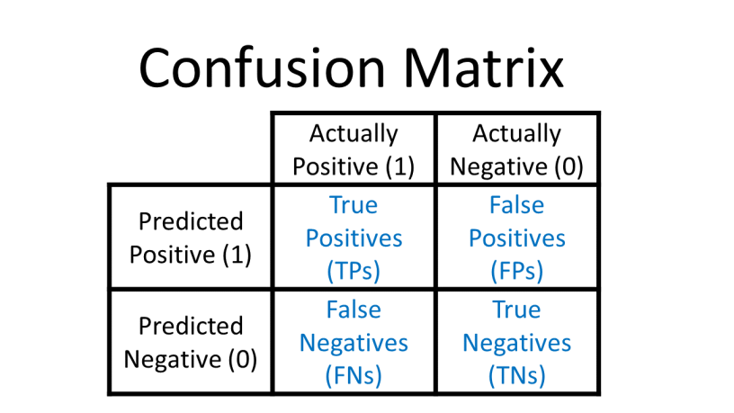
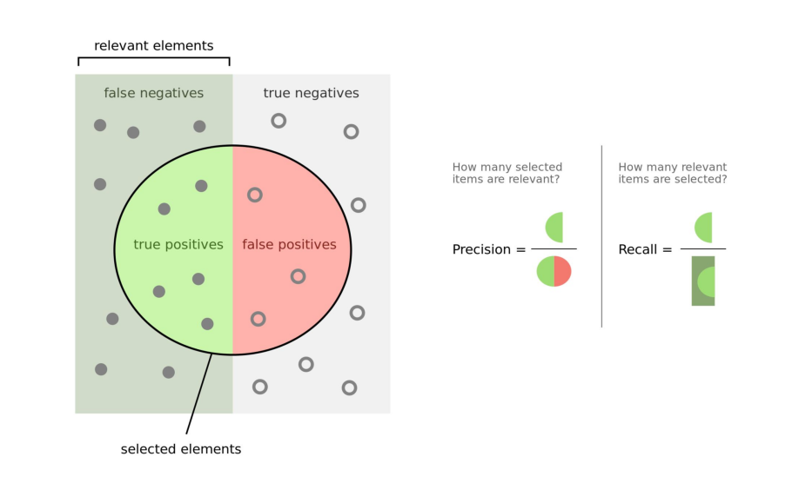
How to evaluate ML Model

Slide 22
THANK YOU

